Slide 1

Student Details
Name: Rajat Gupta
SkillsBuild Email ID: er.rajatgupta123@gmail.com
Collage Name: Pranveer Singh Institute of Technology
Collage State: Uttar Pradesh
Internship Domain : Data Analytics(DA)
Start and End Date: (12-06-2023 to 24-07-2023)

Slide 2

PROJECT TOPIC
Case Study: Analysis of Superstore Dataset
PROBLEM STATEMENT
The Superstore dataset requires analysis to identify sales, customer behavior, and product performance insights, impeding informed decision-making and hindering operational efficiency, profitability, and customer satisfaction improvements.

Slide 3
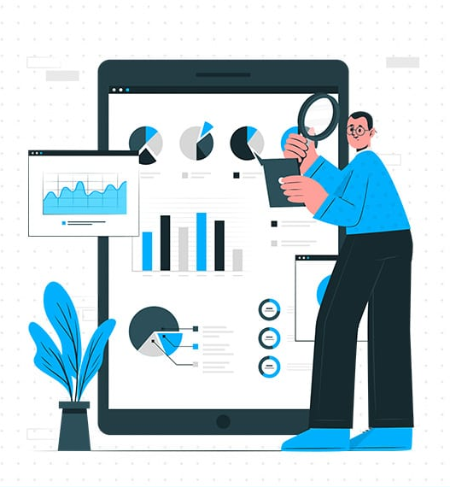
AGENDA
The agenda for analyzing the Superstore dataset comprises an introduction and dataset overview, data cleaning and preprocessing, exploratory data analysis (EDA), and descriptive analysis. EDA will focus on visualizing sales trends and patterns, while descriptive analysis will provide statistical measures and actionable insights to enhance business strategies and customer satisfaction. The analysis aims to optimize operational efficiency, identify key factors influencing profitability, and drive data-driven decision-making.

Slide 4
PROJECT OVERVIEW
The purpose of this project is to conduct a comprehensive analysis of the Superstore dataset to gain insights and uncover patterns in sales, customer behavior, and product performance. The project aims to provide valuable insights to stakeholders and facilitate informed decision-making to enhance operational efficiency, profitability, and customer satisfaction.
SCOPE
The scope of the project includes data cleaning and preprocessing, exploratory data analysis (EDA), and descriptive analysis. Data cleaning will involve handling missing values, outliers, and duplicates, while EDA will focus on visualizing sales trends over time and analyzing sales patterns across regions, categories, and sub-categories. Descriptive analysis will provide statistical measures and actionable insights related to sales, customer behavior, and product performance.
OBJECTIVE
The objectives of the project are to identify key factors influencing profitability, optimize business strategies, improve inventory management, and enhance marketing initiatives. By leveraging the power of data, the project seeks to uncover trends, patterns, and correlations within the Superstore dataset, enabling stakeholders to make data-driven recommendations for enhancing overall performance and revenue.

Slide 5

Who are the End Users?
The end users of the analysis conducted on the Superstore dataset are stakeholders within the organization, including executives, managers, and decision-makers responsible for business strategies, operations, and marketing. The insights derived from the analysis will guide their decision-making processes to optimize sales, customer satisfaction, and overall performance.

Slide 6

Solution and Value Proposition
Our solution to the analysis of the Superstore dataset addresses the needs of end users by providing valuable insights. Through data cleaning, exploratory data analysis (EDA), and descriptive analysis, we uncover trends, patterns, and correlations related to sales, customer behavior, and product performance. This enables stakeholders to make informed decisions, optimize business strategies, enhance operational efficiency, and improve customer satisfaction. By leveraging data-driven insights, our solution brings tangible value by driving profitability, streamlining processes, and guiding targeted marketing initiatives, resulting in enhanced overall performance and revenue growth for the organization.

Slide 7
How did you customize the project and make it your own
Utilized customized data cleaning techniques: I applied specific data cleaning methods to address the unique challenges present in the Superstore dataset. This ensured that the data was cleansed and prepared appropriately for analysis.
Employed advanced exploratory data analysis (EDA) techniques: In addition to standard EDA approaches, I utilized advanced techniques to uncover insightful patterns and trends within the Superstore dataset. These methods allowed for a more thorough understanding of the data and revealed hidden relationships.
Aligned analysis with stakeholders' objectives: I focused on key metrics and statistical measures that directly aligned with the goals of the stakeholders. By analyzing the data through the lens of their objectives, I provided actionable insights aimed at improving operational efficiency, maximizing profitability, and enhancing customer satisfaction.
Incorporated industry expertise and best practices: I leveraged my knowledge of the industry and best practices in data analysis to enrich the analysis of the Superstore dataset. By combining this expertise with the dataset's insights, I provided valuable recommendations that were both data-driven and relevant to the specific business context.

Slide 8
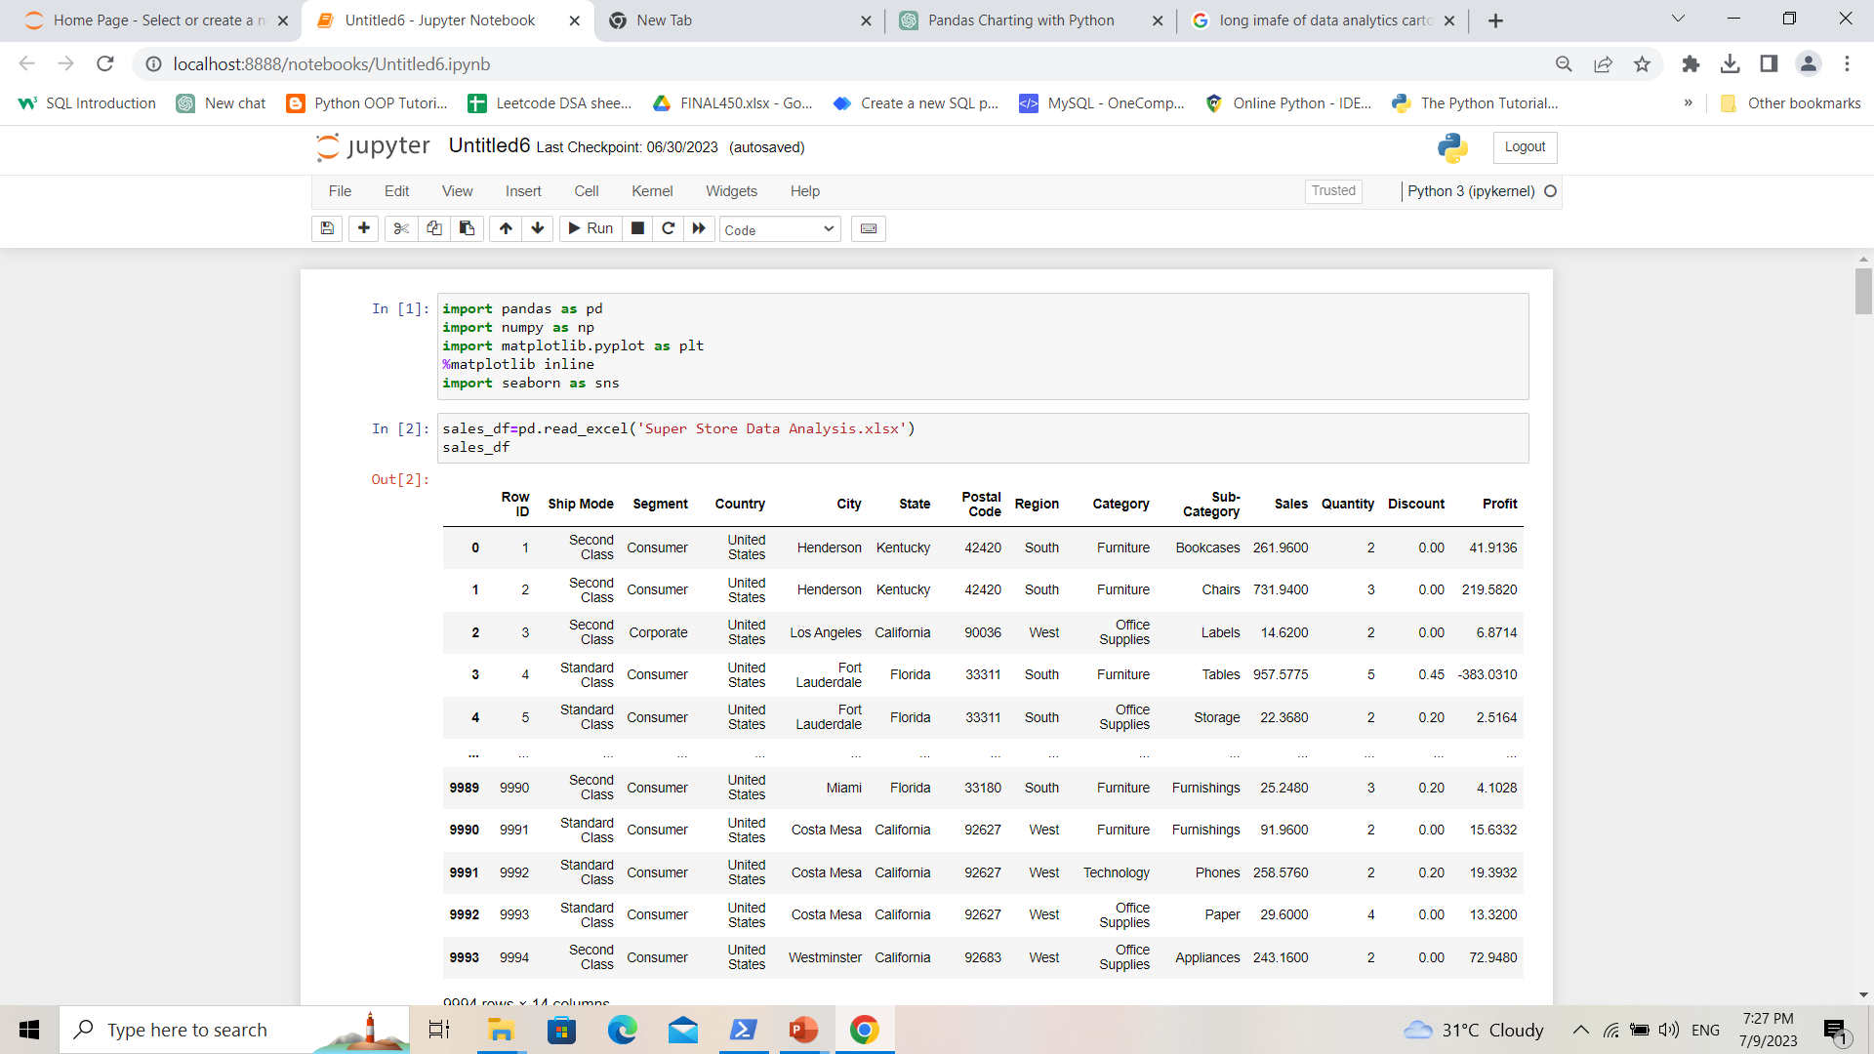
MODELLING
Firstly we have to import all the necessary libraries and load the Superstore Dataset to a Jupyter Notebook and then Clean the Dataset if there are any wrong data in that dataset.

Slide 9
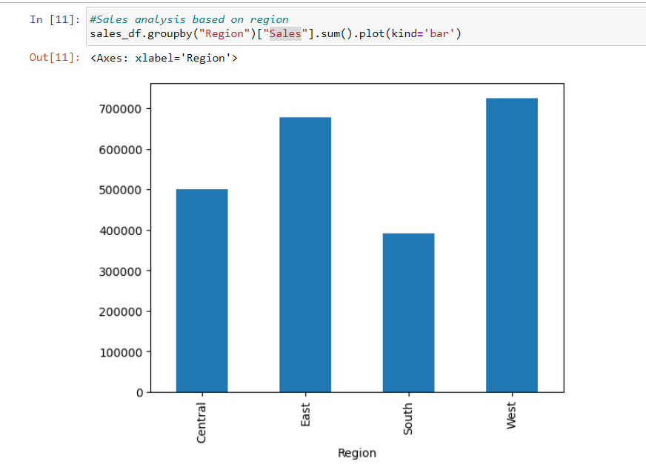
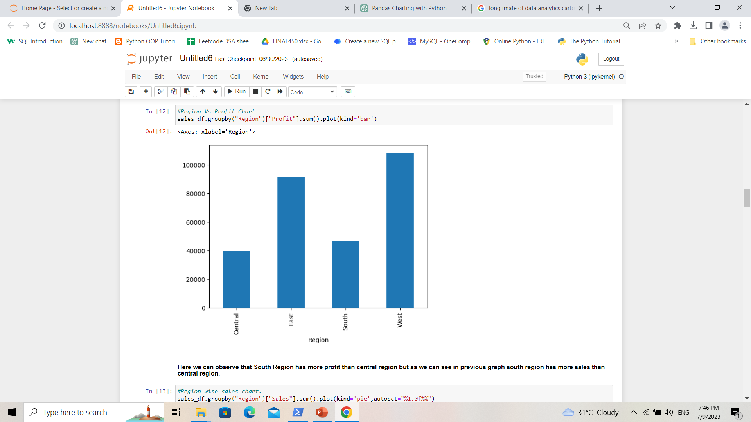
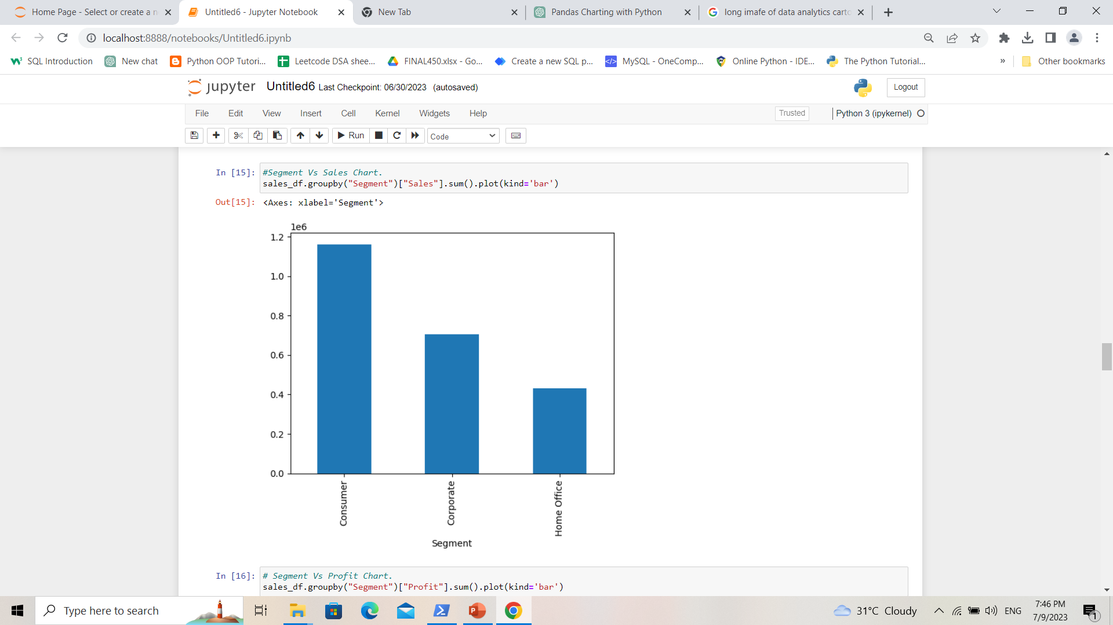
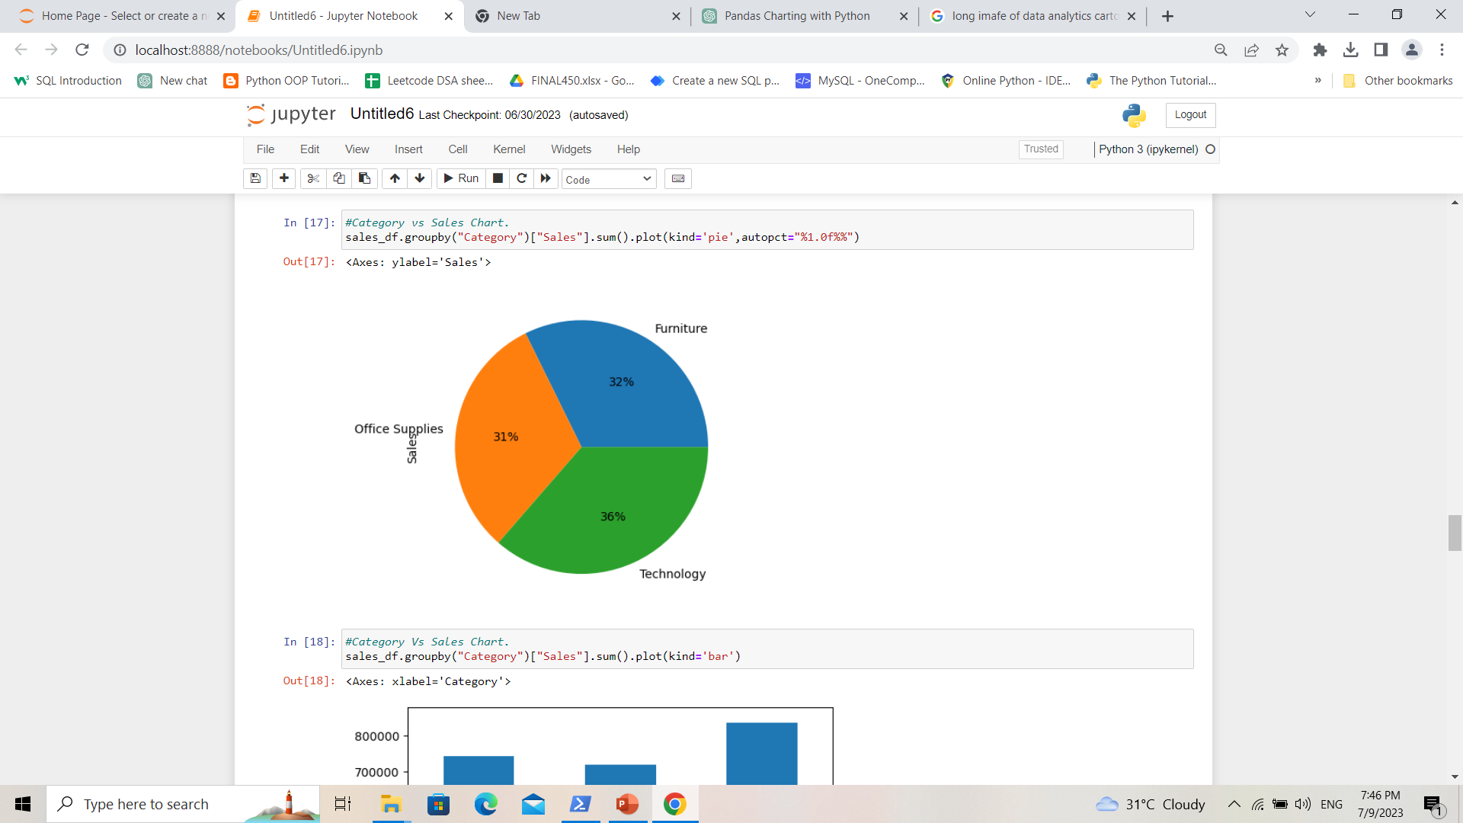
The chart is giving the information of sales analysis based on region. Here we can see west region has high sale and south region has low sale.
The Chart is giving the information of Profit at every region. So, here west region gives highest profit and central region gives low profit even it has more sale than south but it gives low profit.
This chart shows that consumer segment has highest sale and Home office segment has low sale that means we should focus on consumer segment more for the high sale.
This chart shows that all category has almost same sales.

Slide 10
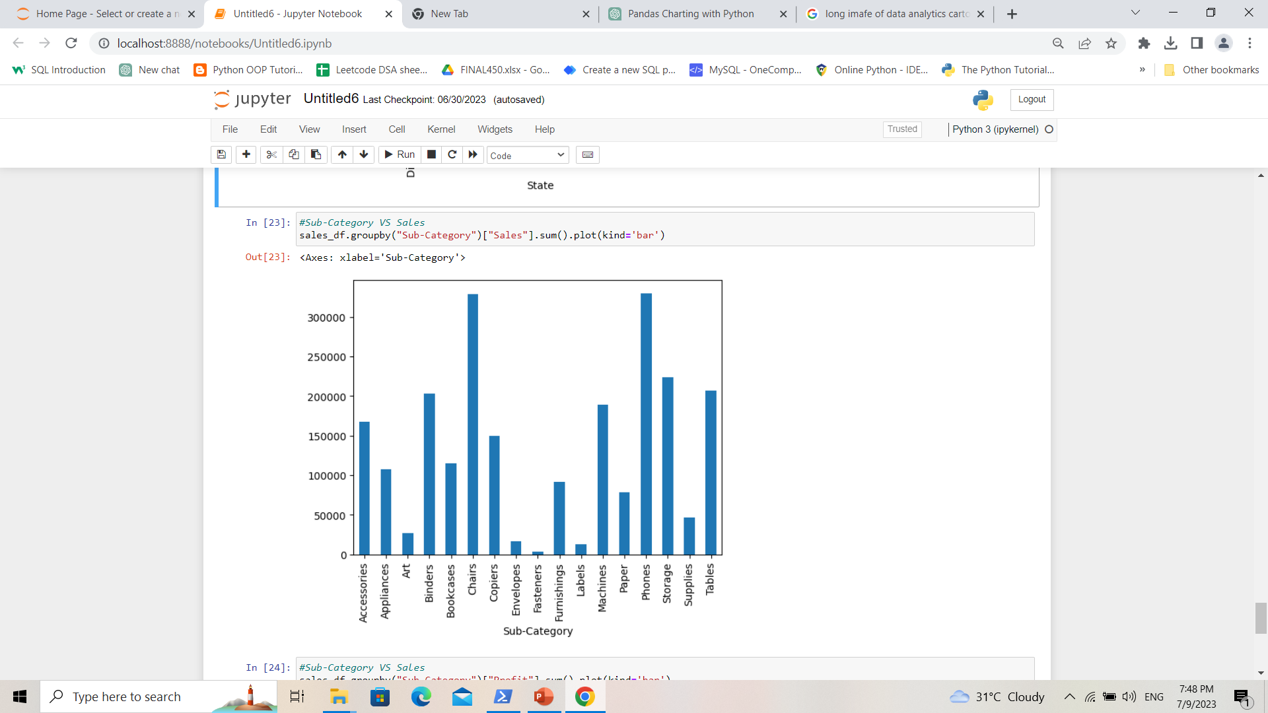
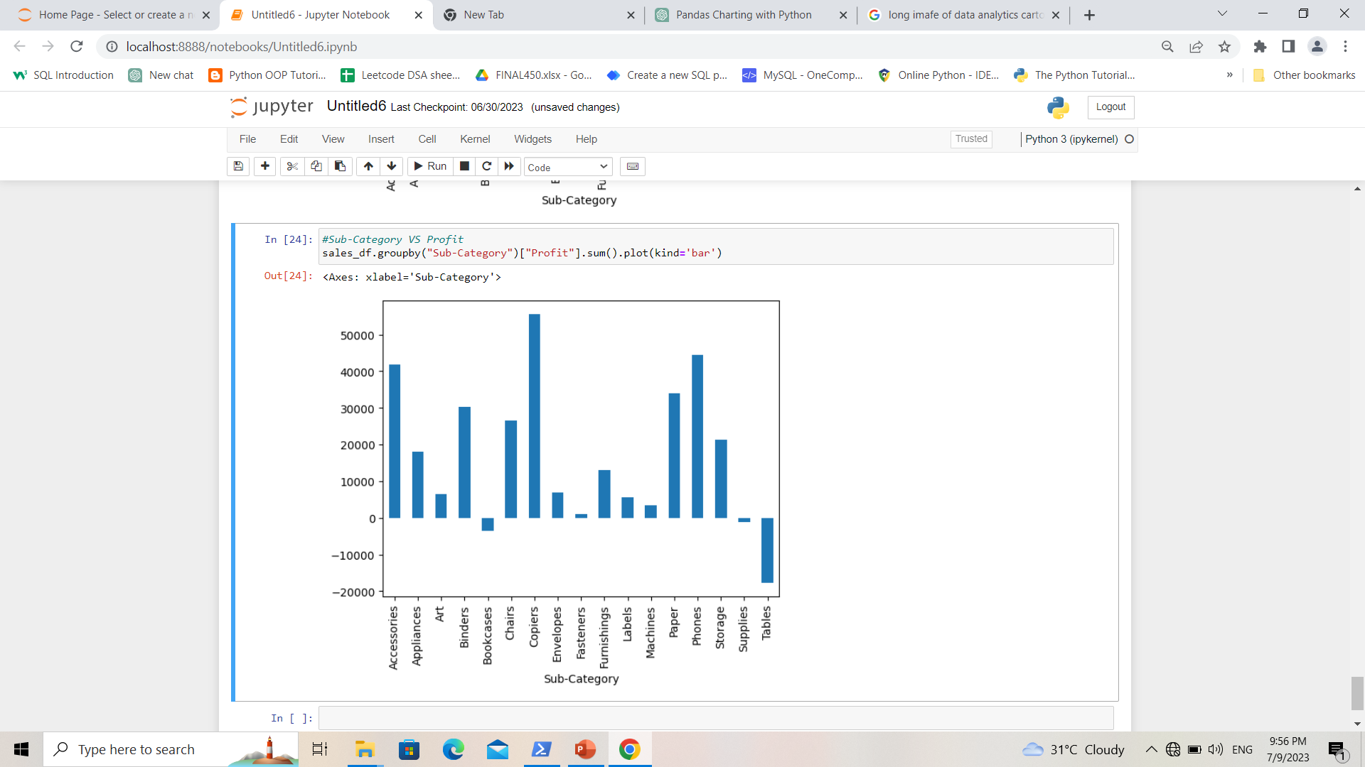
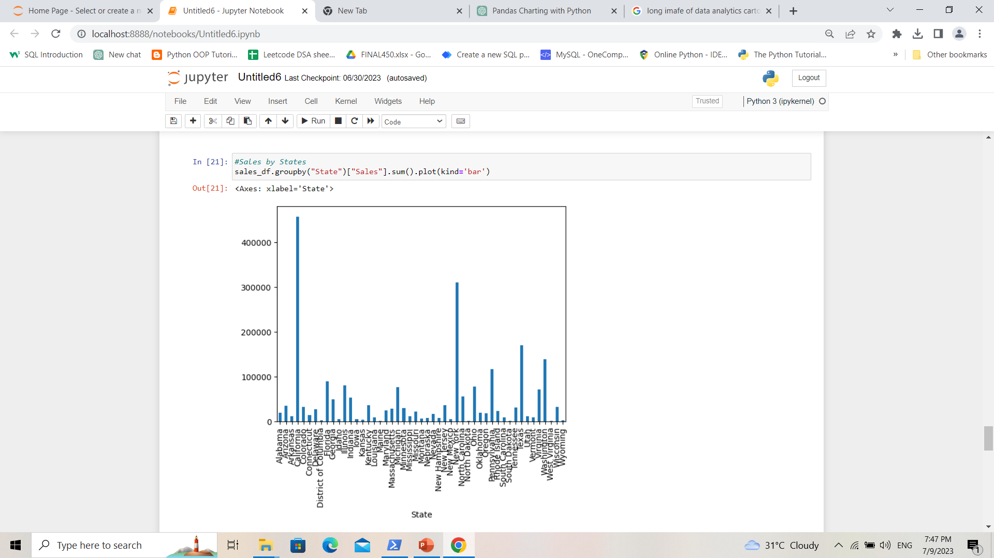
This chart shows Sales by Sub-category. Here chairs and phones has high sale.
This chart shows the profit and loss by sub-category. Here copies gives highest profit and tables gives highest loss.
This chart shows the Sales by states. Here California state has highest sales and New York has second highest sales.

Slide 11
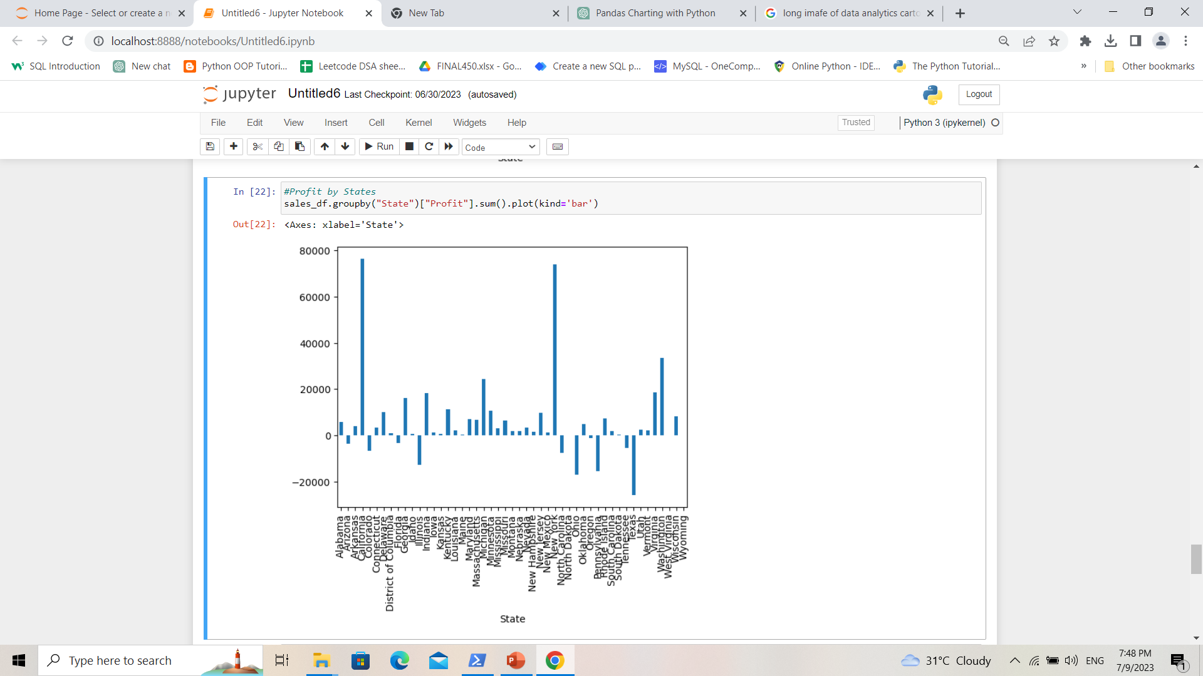
This chart gives the information about profit and loss by every states. Here we can see that California and New York has highest profit and Texas state give highest loss. So we Should focus on that states for Sales Improvement.

Slide 12
RESULT
The analysis of the Superstore dataset reveals several significant insights. Firstly, when examining sales by region, it is evident that the West region demonstrates the highest sales, while the South region lags behind with lower sales figures. On the other hand, analyzing profit by region uncovers that the West region is also the most profitable, whereas the Central region, despite its higher sales compared to the South, yields comparatively lower profits.
Furthermore, an analysis of sales by consumer segment highlights the dominance of the consumer segment in driving overall sales, emphasizing the importance of focusing on this segment to further enhance sales performance. When considering sales by category, it becomes apparent that all categories contribute relatively equally to the overall sales figures, indicating a balanced distribution of sales across various product categories.
Digging deeper into the sub-categories, the sales analysis reveals that chairs and phones are the top-selling items, capturing a significant portion of the market demand. However, when assessing profitability by sub-category, copies emerge as the most profitable, while tables show the highest losses.
Finally, examining sales by state indicates that California leads in terms of sales, followed by New York. Conversely, Texas shows the highest losses, emphasizing the need to concentrate efforts on improving sales performance in that state. These insights provide valuable guidance for stakeholders to optimize strategies, improve operational efficiency, and enhance profitability within the Superstore dataset.

Slide 13
LINKS
Code on GitHub:-

